Slide 1
NFD Profiling

Slide 2
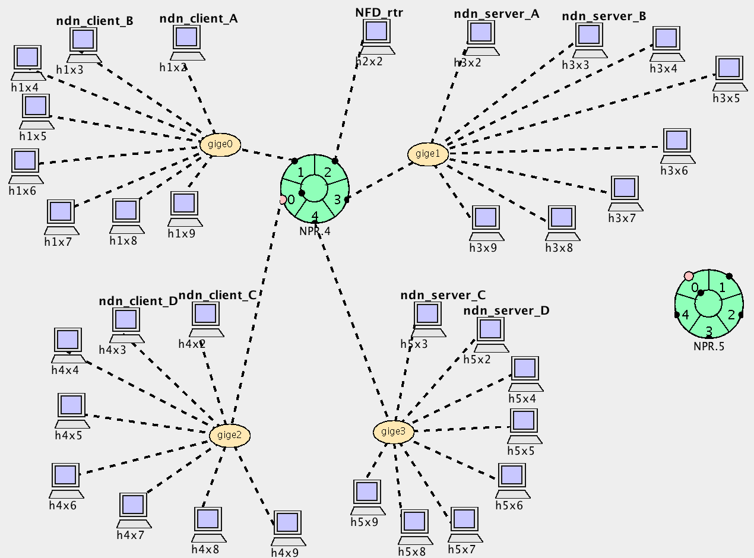
Experiment Setup
64 NDN traffic client-server pairs are connected through a NFD router, generating gprof report
4 clients on a machine inject unique Interests to fetch Content
Medium name length (5 name components, each has 5 characters)
5ms interval for Interest => ideally 384k Interests
Notes:
Network-Processor Routers (NPRs) are our second generation routers. We have 14 NPRs, each with five ports. At the heart of an NPR is a high-performance IXP 2800 network processor.
(http://wiki.arl.wustl.edu/onl/index.php/Main_Page)

Slide 3
Results
gprof results ranked by total self seconds
Top functions:
Shared_ptr: to simplify the memory management. Currently it is everywhere in the NFD
Content store functions: both find() and insertToSkipList() have high self seconds
Name functions: compare() has the highest self seconds
Block destruction function surprisingly has a higher self seconds
Base class, pretty much everywhere
Notes:
Easily identify the bottlenecks based on specific functions’ self seconds in the whole process

Slide 4
Results (cont.)
gprof results ranked by self us/call, identify the implement issues
Top functions with enough samples
Ndn::name::component::toUri
Nfd::Cs::find
Nfd::Cs::insertToSkipList
Observaion:
Content Store functions need better implementation/design
Name::Component::toUri function may need to be improved
Others are under us level
Notes:
Identify functions based on self us/call, but ignore the functions without enough samples, due to sampling errors (time is not precise), double checked by print out the clock time (add code)

Slide 5
Results (cont.)
Modules ranked by categories
boost - 20.26% (shared_ptr accounts for 10%)
nfd::Cs - 13.59% (insert and find take about 12%)
ndn::Name - 10.36%
block - 10.19%
ndn::Data - 4.03%
nfd::Forwarder - 2.02%
nfd::NameTree - 1.53%
nfd::Pit – 1.43%
Observations
Content Store module, boost library functions, name module, and block module have the highest self seconds
Notes:
Name is the class, name is the nameapsce
Identify the module that spent most of the time

Slide 6
Results (cont.)
Call graph
Common functions
boost::detail::shared_count::~shared_count()
ndn::Block::Block functions
nfd::ndnlp::Slicer::Slicer
All nfd::Cs::find calls are from nfd::Forwarder::onIncomingInterest
All nfd::Cs::insertToSkipList calls are from nfd::Cs::insert, which is triggered by nfd::Forwarder::onIncomingData
Observations
Aggressively use of shared_ptr
Block, Slicer, and Name modules are common functions
Content store is event driven functions, no abnormal behavior found
Notes:
Top function boost::detail::shared_count::~shared_count() is a common function, calls from ndn::Block, ndn::Name, and nfd::Nametree, etc.
ndn::Block::Block functions are common for a lot of other functions. nfd::DatagramFace, ndn::Name::getSubName etc.

Slide 7
Conclusions
Shared_ptr, name module, block module, and content store module are the bottlenecks
Shared_ptr is what NFD developers rely on for memory management
Impossible to eliminate
Block module and name module are the common base for other functionalities
Impossible to eliminate
Content store is event driven, much slower than PIT (event driven too)
Need redesign or re-implementation

Slide 8
Appendix
When #char in each segment varies …
Does not affect the module portion results much
When less #segments used …
Total time spent on CS module is more, but block and Name is lesser
NFD spent less time on Name and block processing , so enough time to handle packets. Specially, the time to handle CS operation is less when less #segment used.
Notes:
http://redmine.named-data.net/issues/1621
onIncomingInterests: 10.37/16.35 = 63%
nfd::Pit::insert (71%)
nfd::NameTree::lookup (99%)
nfd::NameTree::insert (54%)
nfd::name_tree::computeHash (82%)
ndn::Name::wireEncode (87%)
ndn::Block::parse (57%) – call othe block functions or boost functions
ndn::Name::getSubName (34%)
std::vector (62%)
nfd::Cs::find ((1.56 + 0.69)/(10.37 + 0.03) = 21%)
ndn::Name::compare (other funcs also called)
onIncomingData: 20%
nfd::Cs::insert (71%)
nfd::Cs::insertToSkipList (92%)
ndn::Name::compare (56%)

Slide 9
Critical Path
onIncomingInterests: 45%
nfd::Pit::insert (44%)
nfd::NameTree::lookup (98%)
nfd::NameTree::insert (58%)
nfd::name_tree::computeHash (66%)
ndn::Name::wireEncode (89%)
ndn::Block::parse (51%)
ndn::Name::getSubName (26%)
std::vector (63%)
nfd::Cs::find (37%)
ndn::Name::compare (32.6%)
onIncomingData: 36%
nfd::Cs::insert (62%)
nfd::Cs::insertToSkipList (82%)
ndn::Name::compare (38.8%)

