Slide 1
NDN-RTC
Peter Gusev
UCLA REMAP
5/22/2014
Notes:
NDN-Real time communication library
Overview past progress on the project, current state of it and our future steps

Slide 2
Agenda
Overview
Implementation approaches
  Browser add-on
  WebRTC
  Stand-alone library
Overview
  Publishing data
  Consuming data
  Namespaces
NDN-RTC design
Demo app
  How to: get, install & use
Future steps
Notes:
I’m gonna start with the overview of main project goals which were set up in july of the last year
And I’m gonna evolve chorologically over the implementation process which highlights first implementation approach as a browser addon, faced difficulties with that and how we proceed.
Then there’ll be an overview of the current libraryr
Two version of it’s design
And I’ll conclude how you can get&use alpha releases and describe our future steps.

Slide 3
NDN Real Time Conferencing Tool
Goals:
  Real-time audio/video/text chat library which allows many-to-many conferencing over the NDN network and requires no direct communication between peers
  Traffic generator for the testbed
  Start point for NDN traffic congestion control algorithm research
  Test NDN-CPP library and TLV packet format
Notes:
So our main goal was to implement production-level application which allows real-time audio/video multi-party conferencing tool (with the possibility of text chat as well) over the NDN network.
App should leverage current implemented libraries such as NDN-CPP and ChronoSync, possibly integrate ChronoChat for text chats.
Also app is expecting to generate a lot of NDN traffic which could serve as a starting point for congestion control algorithm research and of course TLV packet testing

Slide 4
NDN-RTC library
C++ code
Linked against NDN-CPP and WebRTC libraries
Interfaces:
  Publish media (audio/video) streams
  Fetch media (audio/video) streams from multiple producers
Demo app is provided
  Publishing audio/video stream
  Fetching audio/video streams (multiple)
“Experimental alpha” state
  RTC functions only (simple trust model – sign/verify, no conference discovery yet)
Notes:
linked against NDN-CPP and WebRTC libraries and provides real time communication functions

Slide 5
Browser add-on use case
Notes:
As by this time, the actual code of real time communication over the NDN had not been written yet, we decided to proceed and focus entirely on the core of add-on and implement a stand-alone library

Slide 6
WebRTC
www.webrtc.org
Included in the browser (Firefox, Chrome, Opera)
RTC media processing:
  Video: encoding (VP8/9), rate adaptation, retransmissions
  Audio echo cancellation, gain control, A/V synchronization
Peer-to-peer connection mechanisms (ICE, TURN)

Slide 7
WebRTC (cont.)
Tightly coupled with RTP/RTCP
  Packets synchronization
  Congestion control
  Feedback channels (RTCP)
Has interfaces for external transport
  Allows registering callbacks for transferring individual RTP/RTCP packets
Notes:
As a part of a project, big amount of time was spent for analyzing WebRTC library and how it can be employed in NDN-RTC
It turned out that WebRTC extensively uses RTP/RTCP channel for media transfering.
It also turned out that its classes are tightly coupled with RTP meaning that media streaming and rate control algorithm is highly relying on RTP/RTCP channels
However, WebRTC provides interface for external transport which should manage delivery of RTP and RTCP packets between the peers

Slide 8
WebRTC in NDN-RTC
Avoid using RTP/RTCP
NDN-RTC employs some video classes from the video pipeline (allows individual frames access):
  VP8 encoder/decoder
  Frame capturer
  Video renderer
NDN-RTC works as an “external transport” for the audio pipeline (preserves echo cancellation, gain control, etc.)

Slide 9
User namespace
Root:
  User prefix (username)
Stream:
  Media streams (audio/video)
Bitrate:
  Media stream bitrate
Stream info:
  Media stream encoding info (number of threads, actual framerate, bitrate, etc.)
Frame type:
  Key and Delta frame in separate branches
Packet:
  Individual media packets (audio samples, encoded video frames)
Data type:
  Data and Parity segments in separate branches
Segments:
  Actual NDN-data objects
Notes:
Each user of NDN-RTC app is uniquely identified by a prefix URI which contains username.
a producer publishes media streams under streams namespace as presented
Each stream is encoded with its own symmetric key
Producer can publish one particular stream in several copies with different encoding parameters
The information about streams’ encoding parameters can be accessed by issuing interest in codec info namespace which will be satisfied with the content object containing encoding information
Please note on the scheme “acces” and “sym-key” components purpose of which I’ll explain further

Slide 10
User namespace (cont.)
Stream namespace: each stream can have several threads with different parameters (bitrate, framerate, etc.)
Stream metadata is stored under stream info prefix: …/video0/info

Slide 11
User namespace (cont.)
Separate namespaces for different frame types (KEY and DELTA)
Frames numerated sequentially (consumer which number to fetch next)
Two types of data per frame: Data and Parity
Frames numbering namespaces

Slide 12
NDN-RTC overview
Two types of data:
  Media (audio/video)
  Meta (encoding info)
Producer buffers data:
  in the app cache
Metadata fetching – 1Hz
Media data fetched at producer rate
Notes:
Two types of data:
Media (audio/video)
Meta (encoding info, discovery, etc.)
Publishes content into the local content store
No library-based buffer/repo
CS is used for buffering of data publishing
freshness seconds

Slide 13
Publishing
Encoded frames^{(1000kbit/sec)}:
  Key: ~30KB (20 segments)
  Delta: ~1-6KB (~4 segments)
Producer “pokes” segments into CS or stores them in app cache
  Segment size - 1000 bytes
  NDN overhead - ~337 bytes
  Complete segment – 1500 bytes
Notes:
1.

Slide 14
Segmentation
Packet header:
  Packet-level info:
    media-specific info
    timestamp
    current packet rate
Segment header:
  Segment-level info:
    Interest nonce
    Interest arrival timestamp
    Generation delay
  Packet-level info:
    Total segments number for the frame
    Frame playback #
    Corresponding sequence number from paired namespace

Slide 15
Consuming

Slide 16
Consumer modes
Chase mode – exhaust network cache in order to get the latest data from producer
Fetch mode – pipeline interests to keep the buffer size at target

Slide 17
Frame fetching
Generation delay d^{gen} – time interval between receiving an interest and satisfying it with data
Assembling time d^{asm} – time needed to fetch all frame segments
RTT_{n} – consumer-measured round trip time for the interest

Slide 18
RTT estimation
RTT_{n} = nRTT_{n} + d_{n}^{gen}
RTT – current round trip time for the network
d_{n}^{gen} – frame generation delay (reliable if nonce values are equal)
RTT_{n} - consumer-side measured round trip time

Slide 19
Frame fetching based on frame type
Key and Delta has different number of segments
Consumer should know beforehand what kind of frame will be fetched next in order to make a “best guess” for the number of initial interests

Slide 20
Interest pipeline and retransmission approach
B₁ >= RTT, B₂ >= RTT
Minimal buffer size >= 2*RTT milliseconds

Slide 21
Chase mode
Cache exhausting:
  Latest data can not arrive faster than it’s being produced
Chase mode:
  issue interest for the RIGHTMOST segment
  upon receiving first segment (frame F₀) – start issuing interest for F₀+1 frame with interval d^{int} < Producer rate
  Monitor d^{arr} – frame inter-arrival interval:
    If d^{arr} is increasing – continue fetching
    If d^{arr} is stable – switch to “Fetch“ mode

Slide 22
Chase mode (cont.)

Slide 23
Forward Error Correction
OpenFEC library
Producer publishes parity data under separate namespace:
  <frame prefix>/<frame#>/parity/<segments>
Consumer may additionally fetch parity data for enabling FEC
If by the playback time frame is missing any segments – FEC is applied as “last resort”
Amount of parity data is configurable (currently 20%)
Collaborated with Daisuke Ando (M2 Exchange student)

Slide 24
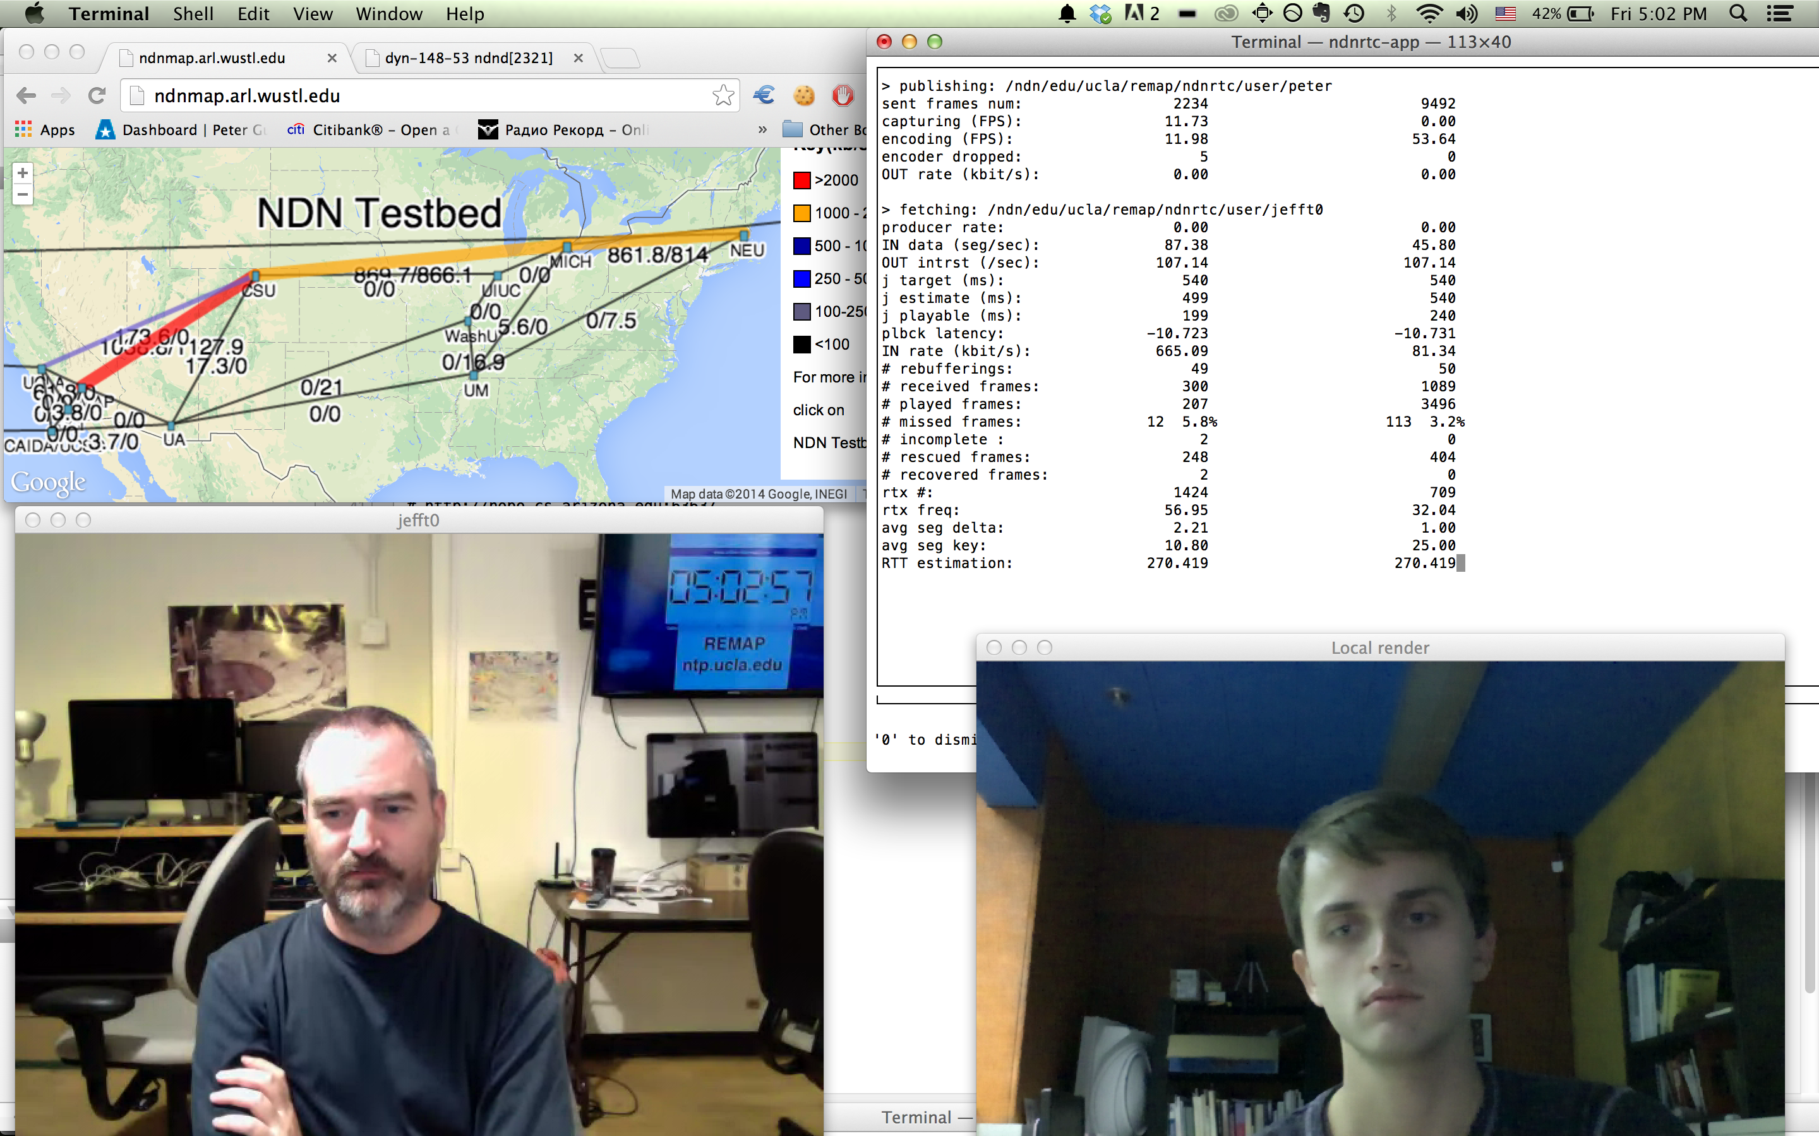
Demo app
Console app
  MacOS X 10.7 and up
  Buildable from sources github.com/remap/ndnrtc
  Redmine
    redmine.named-data.net/projects/ndnrtc
Functionality:
  Publish audio/video stream
  Fetch multiple audio/video streams

Slide 25
Future steps.
Real-time Adaptive Rate Control
Goals:
  Keep low-latency transmission & best throughput
  Maintain RTT fairness (self-fairness)
Consumer-driven
NW bandwidth estimation based on RTT and timeouts
Control interest rate according to bandwidth estimation

Slide 26
Future steps. Rate adaptation (cont.)
In collaboration with Panasonic R&D department

Slide 27
Future steps. Conference discovery
Discovery borrowed from Audio Conferencing Tool
  http://conferences.sigcomm.org/sigcomm/2011/papers/icn/p68.pdf
Broadcast conference roster namespace:
  /ndn/broadcast/ndnrtc/conference-list
Conference description (SDP) is stored in application buffer and satisfies any incoming interests with conference name:
  /ndn/broadcast/ndnrtc/conference-list/morning-talk
All users update conference list by issuing outstanding interests with ExclusionFilter and MustBeFresh flag for known conferences:
  /ndn/broadcast/conference-list?exclusionFilter=monring-talk&mustBeFresh=1

Slide 28
Future steps. Trust model.
Web of Trust
Under discussion
Web Of Trust model for identity verifications
  http://named-data.net/wp-content/uploads/2014/07/ndn-tr-23-chronochat-security.pdf
  Implemented in NDN-CPP library
Media data is encrypted by symmetric key
Access management:
  If Producer A trusts Consumer B, he explicitly sends his symmetric key encrypted by B’s public key to Consumer B

Slide 29
Future steps. Browser plug-in
Developer: Zhehao Wang (REMAP)
Browser integration status:
  Firefox plugin (external NPAPI library) functioning as external renderer.
  Can start/stop publishing/fetching in a browser tab.
Browser integration to-dos:
  UI
  Text chat
  Debugging stage (first release by 8/8/2014)

Slide 30
Tests results

Slide 31
Thanks
Q&A
Peter Gusev
peter@remap.ucla.edu

